Slide 1
Community Service Presentation A.Y. 2025-26
Presented by :
Shayan Mandrekar
SAP:- 70382200006
BTI DS Sem-VII
Roll no- E041
Under the guidance of : Mr. Cynthia Dias

Slide 2
Content:
Overview of the NGO: Live To Give Foundation
Objective: To support underprivileged beneficiaries with medical, educational, and financial aid
My Role: Community service intern focused on outreach, tech assistance, and collaboration

Slide 3

INTRODUCTION TO THE FOUNDATION
Live to Give is a CSR and 80G registered foundation that functions primarily through WhatsApp. It is designed for individuals who may be unsure about how to begin their journey in social service or struggle to find genuine, verified cases of people in need. The platform unites thousands of everyday citizens along with doctors, NGO founders, and bureaucrats, enabling them to collaboratively verify cases and provide both financial and physical assistance—all from the comfort of their homes.

Slide 4
SCOPE OF WORK
During my internship, I contributed in three key areas: beneficiary outreach, NGO collaboration, and digital support. I engaged with over 100 beneficiaries to collect testimonials, assess their needs, and document their experiences in a structured manner. I also participated in strategic discussions with partner NGOs to explore opportunities for collaboration and fundraising. On the digital front, I applied my technical and design skills to enhance the foundation’s social media content and optimize its website presence. This diverse scope of work provided me with valuable hands-on experience in both administrative and creative roles, enabling me to make meaningful contributions across multiple functions.

Slide 5
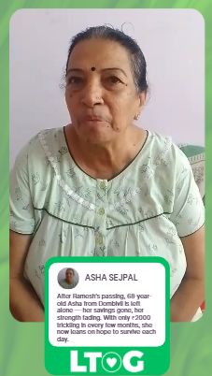
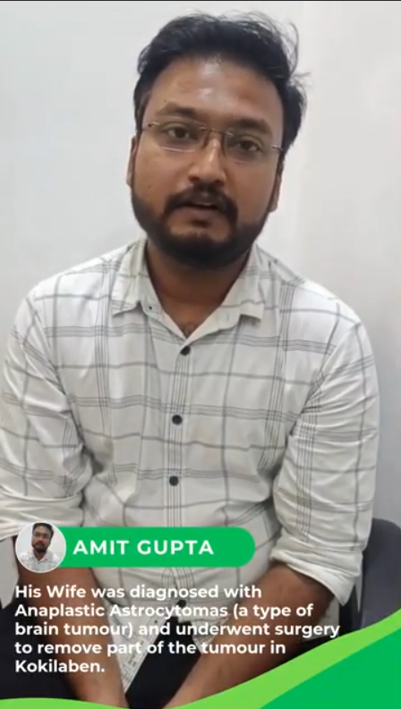
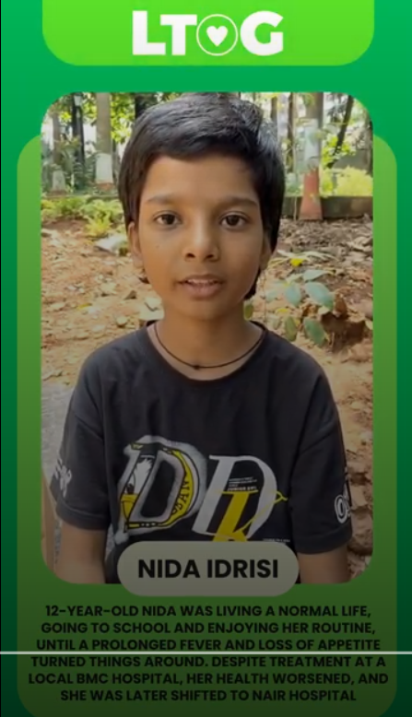
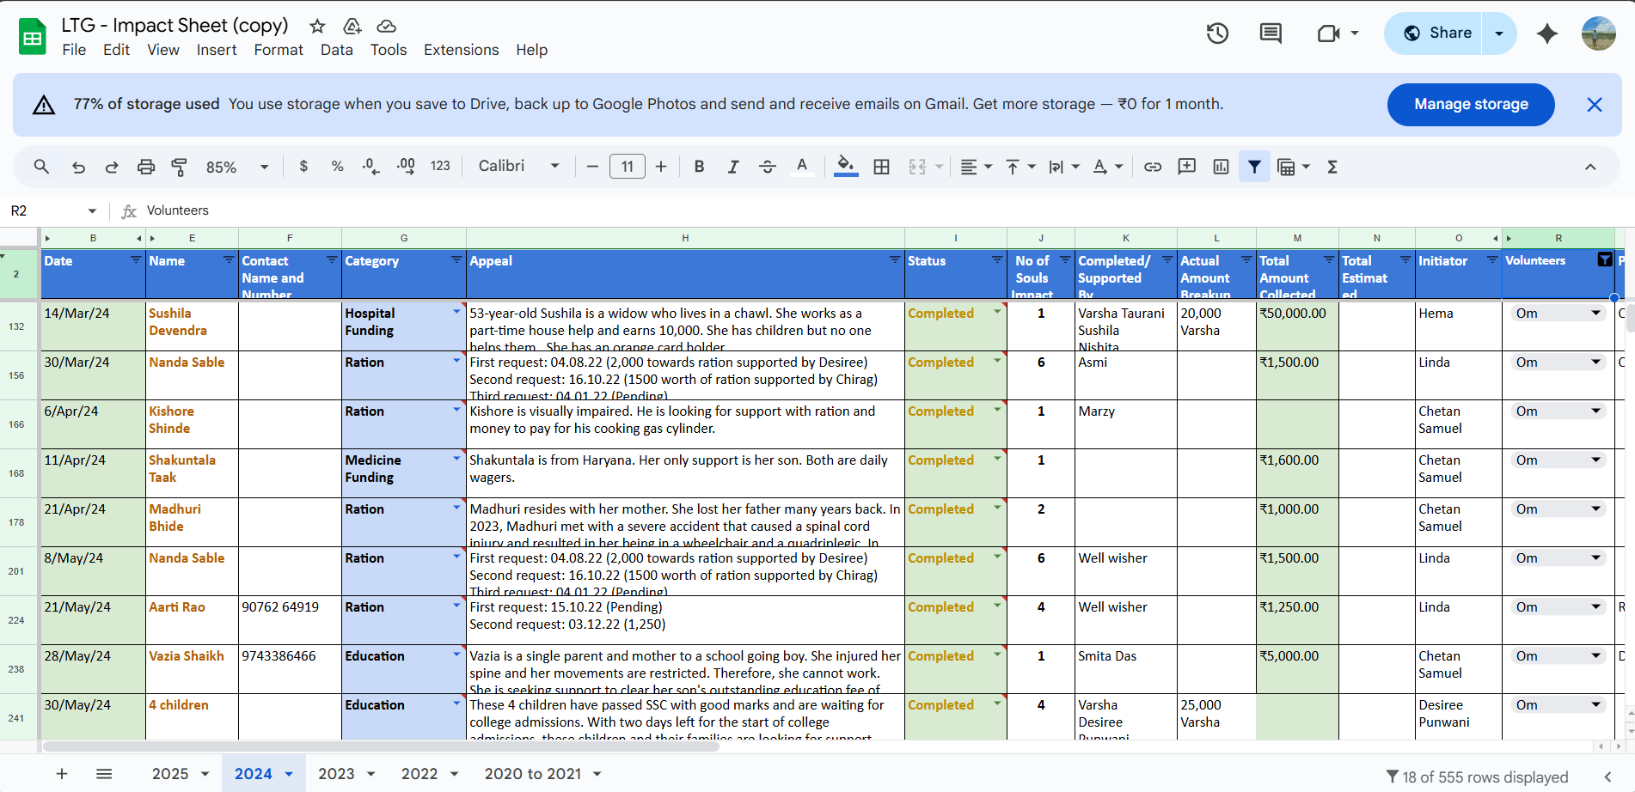
BENEFICIARY OUTREACH
A central part of my work involved collecting and organizing beneficiary testimonials. I conducted phone interviews with individuals receiving aid for education, healthcare, and financial support, ensuring that every conversation was handled with empathy, respect, and confidentiality. Each story was then categorized according to the type and urgency of aid required, creating a structured database that could guide future support efforts. In addition, I introduced improvements to the testimonial documentation format, which helped the team streamline the process and made it easier for future volunteers to carry out outreach more effectively.

Slide 6
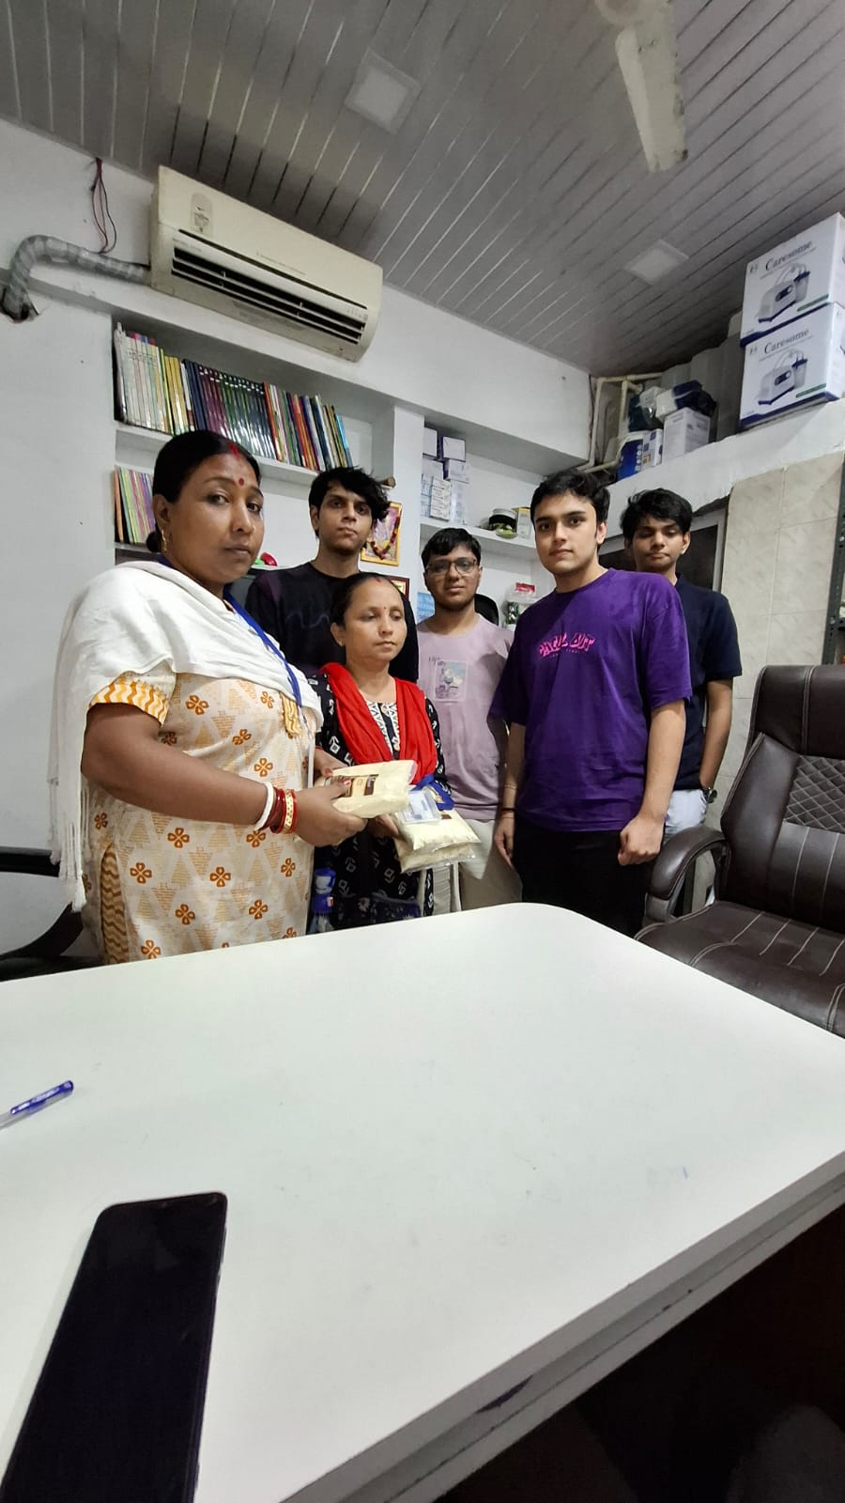
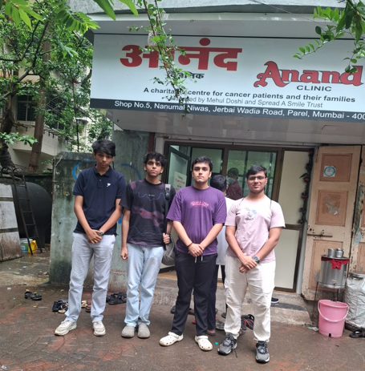
NGO Collaboration & Fundraising
During the internship, I actively collaborated with the founders of other NGOs to explore joint initiatives and partnerships. I attended meetings to align objectives and discuss potential co-hosted campaigns, while also conducting research to identify suitable NGOs for collaboration. My role further extended to preparing proposal presentations and contributing to the design and copywriting of donor outreach materials. These cross-organizational efforts allowed me to gain valuable insights into fundraising strategies, donor engagement, and the critical role of networking within the social impact sector.

Slide 7
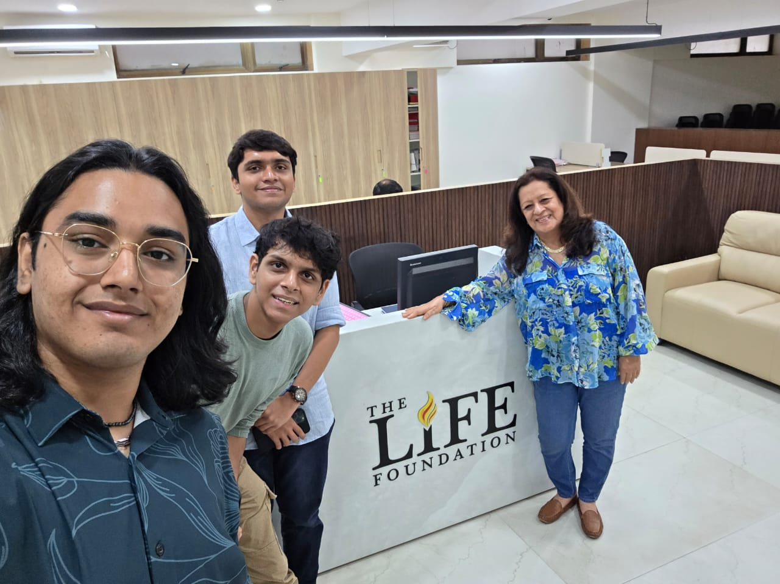
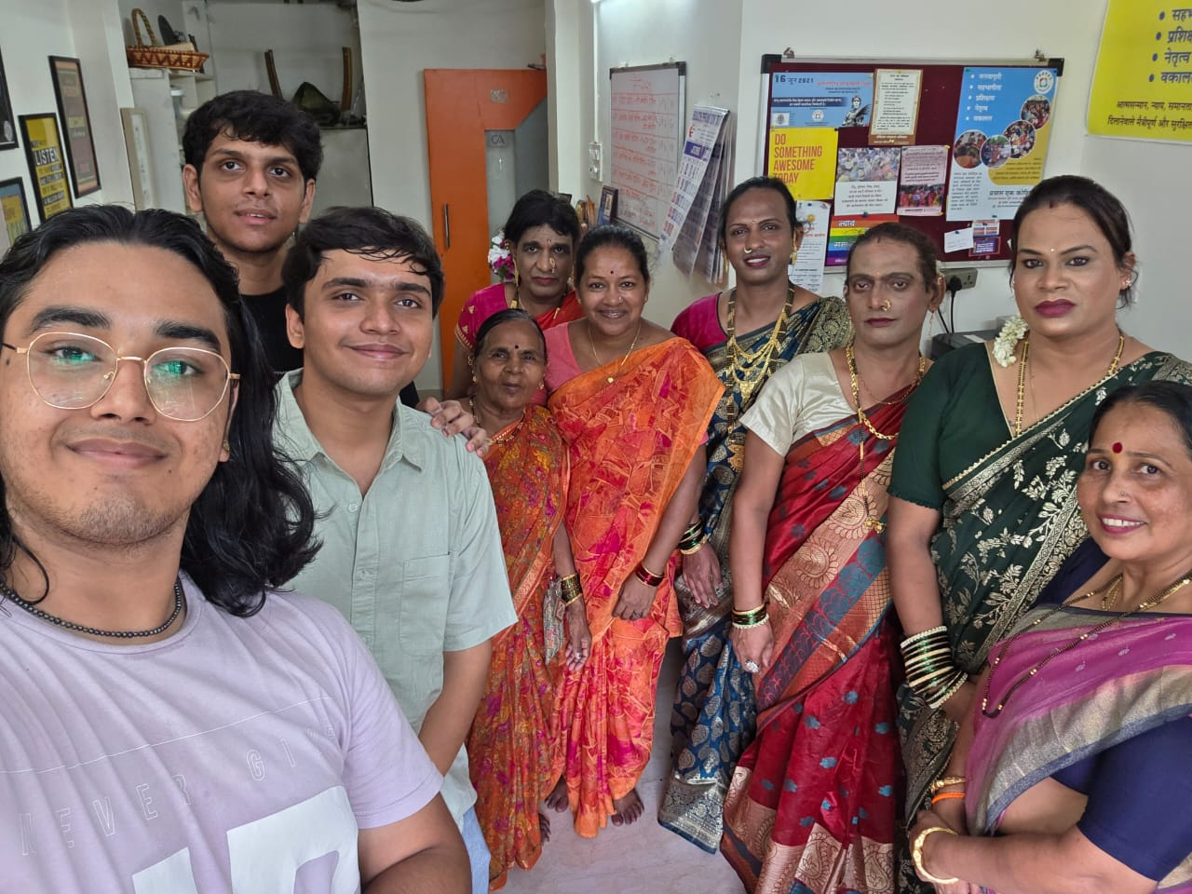

Slide 8
Social Media & Tech Contributions
Leveraging my skills in web design and content creation, I contributed to strengthening the foundation’s digital presence. I designed Instagram posts, LinkedIn banners, and infographic templates to ensure consistent and engaging updates. On the website, I optimized blog layouts and integrated new testimonial sections, which enhanced both usability and storytelling. Additionally, I supported the organization’s social media presence through content creation, editing, and copywriting—efforts that improved visual consistency and boosted audience engagement across platforms.

Slide 9
Learning Experience
This internship proved to be a valuable learning experience, offering me hands-on exposure to outreach, communication, and digital campaigning. It provided deeper insight into how NGOs operate, particularly in remote and hybrid models of service delivery. I learned the importance of empathy while handling sensitive beneficiary narratives and discovered how digital tools can significantly expand impact. The experience strengthened my problem-solving abilities, enhanced my skills in content strategy, and built greater confidence in presenting ideas to both beneficiaries and organizational leaders.

Slide 10
Conclusion
This community service experience with Live To Give Foundation was deeply enriching and transformative. Over the course of 21 days, I was able to contribute meaningfully across outreach, digital, and collaborative initiatives. It allowed me to step out of my academic routine and engage directly with social realities, giving me a better understanding of empathy, responsibility, and structured service. Working with real stories, real people, and real challenges helped me grow both personally and professionally. This journey has strengthened my values and left a lasting impact on how I view social change.

Slide 11
THANK YOU

